Slide 1
Digitalisation
in agriculture and the global food system

Slide 2
Methodological introduction
According to the FAO, 821.6 million people worldwide suffer from hunger and undernutrition, meaning that about one out of nine people does not have enough to eat. Another two billion don’t go hungry, but don’t get enough nutrients with their food and thus can’t live out their full potential and are prone to diseases. It is particularly tragic that many of the malnourished and undernourished live in rural areas – i.e., where food is produced.
High hopes are placed on digitalisation in agriculture and the global food system. New technologies are to contribute to feeding the world’s growing population. However, digital tools and genetically modified high-yield varieties can exacerbate the impoverishment of small producers and threaten biodiversity .
This PowerPoint presentation explores the issue of digitalisation in agriculture and the global food system. It addresses possible benefits and risks involved and is designed as a four corner game: Responses to the questions are assigned to the corners of the room, and students choose one of the corners depending on which of the responses they think is the correct answer. Slides 3 and 4 provide more information for your own preparation. You can find an assessment of the figures on world nutrition for 2019 on Bernhard Walter’s blog at https://info.brot-fuer-die-welt.de/blog/zahl-hungernden-nimmt-weiter
Use slide 5 as the start of the presentation with your students.
You can also use the questions to create a kahoot game and do the quiz in digital format: https://kahoot.com/

Slide 3
Facts and figures
How many people worldwide suffer from hunger and where do they live?
821.6 million people suffer from chronic hunger, accounting for 10.8 percent of the global population or one out of nine people
Hunger is the greatest health risk globally. More people die of hunger every year than of AIDS, malaria and tuberculosis combined. (Source: World Hunger and Poverty Statistics, WHO 2013)
The large majority of people suffering from hunger lives in countries of the Global South (814 million).
About 2.5 billion people lack one or more nutrients essential for health. This nutritional deficiency – as opposed to insufficient food calories – is also referred to as “silent hunger” or “hidden hunger”. One in three people worldwide is affected.
Every year, 3 million children die as a result of malnutrition, 6 children per minute. For every third child who dies as a result of diarrhoea and malnutrition, clean drinking water and sanitation would make a huge difference.

Slide 4
Facts and figures
How have world nutrition figures changed?
Compared to 1990, the number of people suffering from hunger went down from one billion to 795 million globally in 2015, despite a rapidly growing global population. Since then we have seen an increase to 821 million by 2018.
Setbacks in the fight against hunger are mainly due to climate change, conflicts and wars, social inequality and slower economic development. Especially a combination of these factors mixed with poor state structures leads to an increase in numbers.
Can we feed the world?
Yes, global agriculture is adequately equipped for that. The FAO and the United Nations Environmental Program (UNEP) agree on that. The International Assessment of Agricultural Knowledge, Science and Technology for Development report came to the same conclusion already in 2008.
According to the report, small-scale and peasant farming structures – in Asia, Africa and Latin America – are the most important guarantee and represent the best hope for socially, economically and ecologically sustainable food production for a growing global population.
In line with international scientists, Brot für die Welt demands a change of course: from wasting resources to sustainability; from promoting industrialised agriculture to supporting small-scale and peasant agriculture. In recent years, less than half of the world’s grain harvest, namely 47%, was produced to feed people. The remainder was animal feed (34%), fuel/bioethanol (6%), industrial feedstock and waste (13%).

Slide 5
What proportion of the global population is undernourished?
a) 11%
b) 23%
c) 6%
d) 30%

Slide 6
a) 11%
Globally about 821 million people (11%) suffer from hunger. Hunger refers to an individual‘s subjective experience if he*she is unable to acquire sufficient food calories. If the minimum daily caloric requirement of 2,100 kcal is not met over an extended period of time, people suffer from undernourishment.

Slide 7
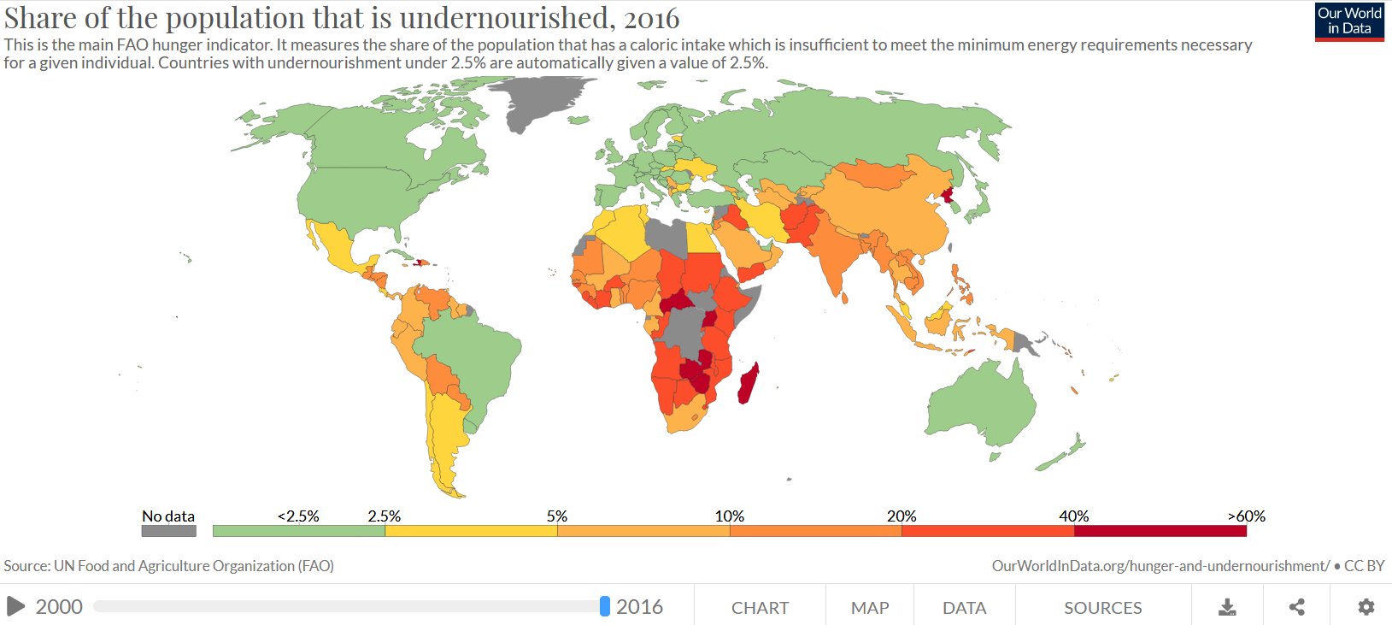
Explore the state of global nutrition and its development from 2000 to 2016 using this map:

Slide 8
Who suffers from “hidden hunger”?
a) People who do not take in sufficient calories because they want to be lean
b) People who take in sufficient calories but always end up craving more
c) People who take in sufficient calories but not enough nutrients
d) People who are unable to acquire sufficient calories, but do not show up in any statistics.

Slide 9
c) People who acquire sufficient calories to meet their energy needs, but suffer from deficient intake of nutrients
Two billion people are malnourished. They suffer from “hidden hunger”. While they are able to meet their daily caloric requirements, their diet does not provide essential micronutrients such as iodine and iron. Perpetual nutritional deficiency damages organs and metabolic processes in humans. In particular, women and children are at risk.

Slide 10
Food security is not a human right.
a) true
b) false

Slide 11
b) false
Food security means that people are at all times assured access to nutritious food that is sufficient to meet their dietary needs. The food supply must also be culturally appropriate and affordable. Everyone has an inherent right to food as enshrined in Art. 25 of the Universal Declaration of Human Rights.
States bear the duty to respect, protect and uphold the right to food. This applies on their own territory and at the international level. 160 states have committed to implementing the right to food. In this regard high hopes are placed on digitalisation.

Slide 12
Can food be digitised?
a) Yes
b) No

Slide 13
a) Yes
Seeds and other plant genetic material can be stored as digital information. Also, more and more parts of the global value chain are being digitalised, which affects all parts of the chain from purchasing seeds to selling food at the supermarket.
Thus we know, for example, that merely one third of the price we pay to buy a tomato is for the tomato itself. 66% of the price accounts for marketing and distribution costs as well as for collecting product- and customer-related data.

Slide 14
The process of collecting a wide range of data and using algorithms for processing them is referred to as...
a) Big Data
b) Huge Information
c) Big Collection
d) Algo Data

Slide 15
a) Big Data
In agriculture, this data can be historic crop yield and weather information, market information, data on input costs for seeds, pesticides and fertilisers, etc. This data is not simply to be collected and stored but also analysed using computer algorithms.
The knowledge acquired is meant to change farming practices and thus, for example, improve efficiency or increase profitability.

Slide 16
What is smart farming?
a) A computer game in which you manage your own farm
b) A university for agricultural engineers
c) The management of agriculture using digital tools
d) A small car used on the fields

Slide 17
c) Digital control of agriculture
Agriculture is part of the global value chain. Digital mapping of the entire process is meant to ease coordination, render the process more transparent and save many resources.
This is also meant to protect the environment by only using resources if they are really needed. Thus, digitalisation is supposed to help feed the world’s growing population.

Slide 18
An example of smart farming
The East African tea market, for example, in Kenya and Rwanda, shows that digitalisation helps increase efficiency, transparency and productivity along the supply chain. Internet access has improved communication among stakeholders. More data is available, and controlling harvests, packaging and shipping can be done via digital platforms.
However, this transparency increases the power of global companies that can now choose their suppliers spontaneously. Profits of local companies go down.

Slide 19
Which of the following benefits is not a result of digitalisation?
a) Targeted use of fertilisers and chemicals
b) Reduction in working hours
c) High-yield varieties
d) More equitable distribution of agricultural land

Slide 20
d) More equitable distribution of farmland
As corporate concentration continues, the industrial food chain is controlled by fewer and fewer people and companies. While digital technologies also allow for the management of smaller plots, in particular smallholder producers often cannot afford these digital tools and high-yield varieties.
With these technologies at their disposal, however, large agricultural corporations become increasingly interested in the land of smallholder producers…

Slide 21
d) More equitable distribution of farmland
…If smallholders are crushed in competition, they are forced to sell their land to the big companies, which increases what is referred to as the concentration of land.
On top of that, high-yielding varieties are not sustainable, but rather use up a lot of resources. They only produce high yields if sufficient fertiliser and water is used.

Slide 22
1% of the global population…
a) uses digital tools for food production
b) owns more wealth than the rest of the population combined
c) can identify genetically modified maize by its smell
d) only eats organically grown vegetables

Slide 23
b) owns more wealth than the rest of the population combined
More and more people own less and less. This growing inequality poses a particular threat within the global food system, for food security then depends on a few corporations. In Germany, for example, only four companies control 85% of the food retail market.

Slide 24
Can seeds be patented?
a) Yes
b) No

Slide 25
a) Yes
Four large agribusiness corporations actually own 67% of global seeds. This gives great power to these companies, but not only that. Their seeds are often genetically modified and threaten biodiversity. 75% of genetic diversity in the most essential crop varieties has already been wiped out.
Genetically modified seeds often rely on the use of chemicals and fertilisers, which smallholder producers and peasants cannot afford. The risk of them becoming indebted to the big companies increases. This is part of the reason why half of the world’s hungry are peasant families.

Slide 26
Which of these crops has not been genetically modified yet…
a) Maize
b) Barley
c) Canola
d) Soy

Slide 27
b) Barley
So far only a fraction of genetically modified (GM) plants, namely cotton, maize, canola and soy are used as food. Instead, the GM plants are used for agrofuels, animal feed and textile production.
It’s still not clear whether GM food crops have adverse impacts on human health. The health consequences of consuming GM plants are still not known, because there are still no long-term studies. In some studies, however, overreactions of the immune system, for example, are put down to GM food.

Slide 28
What is food sovereignty?
a) A nutrition plan for development cooperation
b) A trade agreement between states
c) A right of former kings to levy taxes on food
d) A political concept

Slide 29
d) A political concept
Each individual should be able to subsist in dignity – without destroying the livelihoods of others. All peoples have the right to define their agricultural and food policies themselves. This political concept allows for a variety of ways to achieve sustainable nutrition according to the respective cultural conditions. Digitalisation of agriculture can contribute to this if the needs of smallholders and peasants as well as their financial means are taken into account.

Slide 30
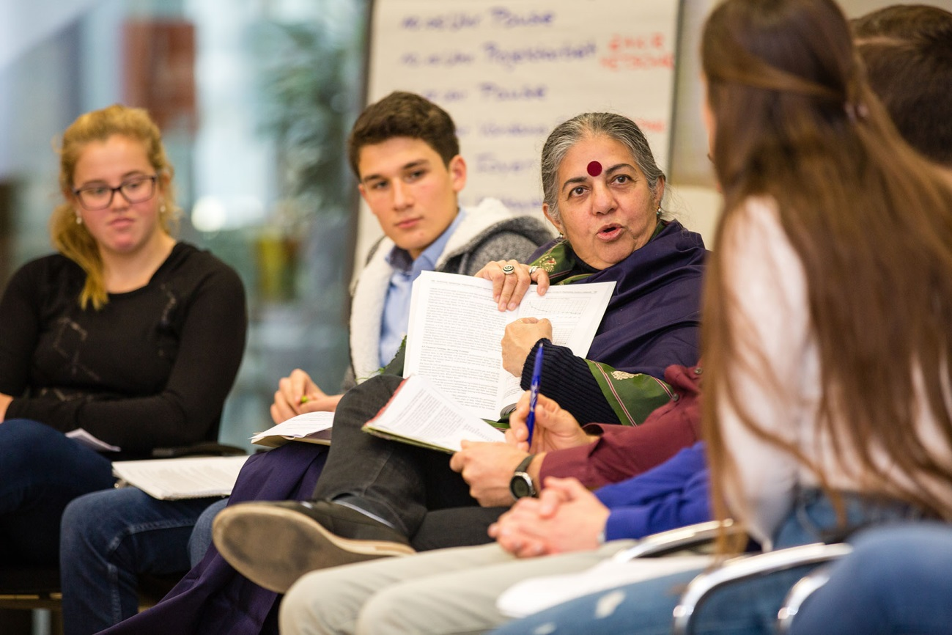
Brot für die Welt in focus
Vandana Shiva’s seed bank helps increase yields
“Many peasant families in India only grow a single crop, for example, cotton. To be able to afford costly hybrid seeds and chemical fertilisers they go into debt. In case of crop failure they can no longer repay their debt and, on top of that, they have nothing to eat because they no longer grow food crops for subsistence consumption.”
Dr. Vandana Shiva in a conversation with students visiting Brot für die Welt in 2018
Vandana Shiva is a physicist, environmental activist, feminist, civil rights activist and critical of globalisation. She is the founder of the organisation Navdanya. In 1993 she received the Right Livelihood Award. In 2004 Navdanya stopped a draft law that was meant to curtail the peasants’ right to use their own seeds.

Slide 31
Brot für die Welt in focus
Vandana Shiva’s seed bank helps increase yields
India Navdanya, a long-standing partner organisation of Brot für die Welt, supports peasant families through, among other things, the creation of seed banks and trainings in sustainable agriculture.
“Navdanya“ roughly means “nine seeds”. The name symbolises the world’s biological and cultural diversity. The organisation was founded in the early 1990s by Dr. Vandana Shiva, a world-renowned scientist and environmental activist. Together with her fellow activists she fights against the industrial agriculture pushed by the Indian state and controlled by multinational corporations like Monsanto that heavily relies on the use of chemical fertilisers and pesticides as well as monocultures.
As part of the project, Navdanya supplies peasant families with traditional seed varieties and offers training in sustainable and organic farming.

Slide 32
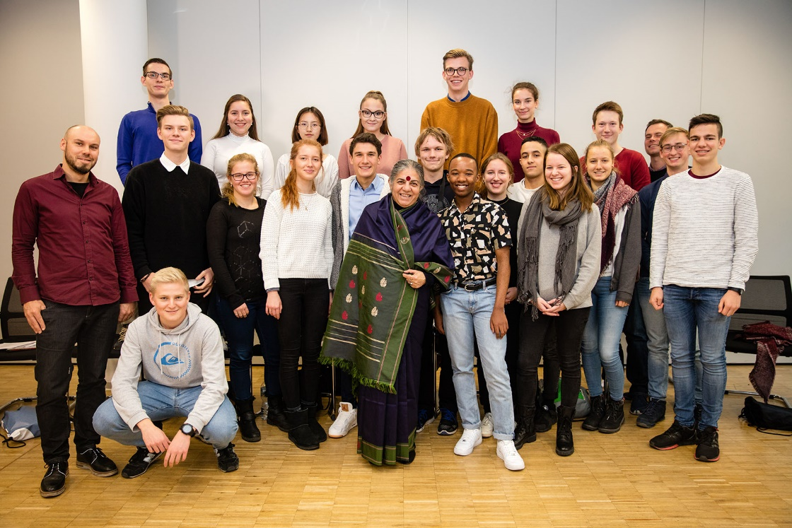
Brot für die Welt in focus
Vandana Shiva’s seed bank helps increase yields
In her book “Soil Not Oil: Environmental Justice in an Age of Climate Crisis”, Vandana Shiva writes:
“Nature shrinks as capital grows. The growth of the market cannot solve the very crisis it creates.”
Divide students into two teams. One team will argue in favour of the statement above, one against.
→ Consider the impacts digitalisation can have on the global food system.
→ Make assumptions as to what could be lines of argument from people from the Global South, and address them in your discussion.
→ Jointly create a concept for sustainable nutrition at your school.
Dr. Vandana Shiva and students at the Georg Büchner Gymnasium in Berlin

Slide 33
Further resources
You can find further resources at:
www.inkota.de/themen-kampagnen/welternaehrung-landwirtschaft/digitalisierung-der-landwirtschaft/
www.righttofoodandnutrition.org/media/publications
www.etcgroup.org
https://viacampesina.org/en/media-and-publications/publications-publications/

