Slide 1
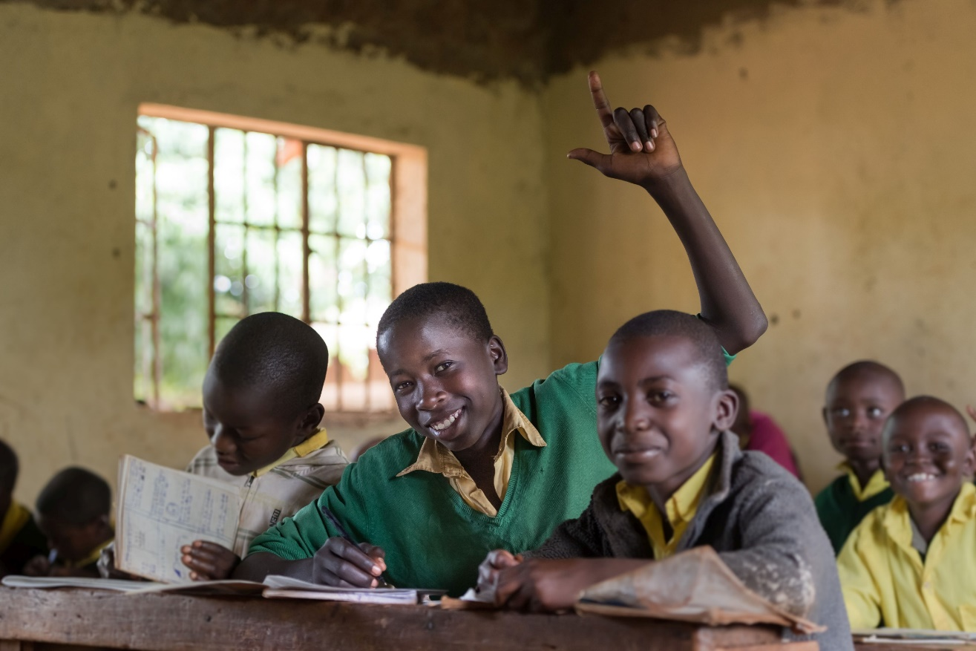
Education for all?
Taking a position on digitalisation in the education system using the example of the Bridge International Academies

Slide 2
Methodological introduction
New technologies can bring many benefits, but sometimes these developments are controversial and have negative effects. The founders of the Bridge International Academies try to solve a common problem through digital innovations: In many countries in Africa and Asia children receive no or no adequate school education. The reason often lies in a lack of teachers.
Bridge International Academies set up a private school model based on the use of tablets. Teachers at the private Bridge schools use the tablets to receive teaching material for each lesson, which they merely have to read out. This way, classes can be highly standardised, controlled and taught by untrained teachers. Many teachers’ unions criticise the model; it’s mostly parents who support it.
This PowerPoint presentation is about the advantages and disadvantages of the model and invites your students to discuss it. Start by gauging the students’ opinions with the five theses below. The students go to the side of the room that they agree with more. They can also place themselves in between, as on a scale. Record the positions of the students on the worksheet.
You can also use “Mentimeter” to gauge the opinions anonymously and digitally. First create a poll at https://www.mentimeter.com. Then ask the students to enter www.menti.com on their smartphones or tablets and to use a specific code (which will be assigned to you when you create the “mentimeter”).
Start at slide 4 with your students!

Slide 3
Worksheet: please print and record results
Thesis 1) | I completely agree! |  |  | I take a different view!
First opinion poll
Second opinion poll
Thesis 2) | I completely agree! |  |  | I take a different view!
First opinion poll
Second opinion poll
Thesis 3) | I completely agree! |  |  | I take a different view!
First opinion poll
Second opinion poll
Thesis 4) | I completely agree! |  |  | I take a different view!
First opinion poll
Second opinion poll
Thesis 5) | I completely agree! |  |  | I take a different view!
First opinion poll
Second opinion poll

Slide 4
1)”Everyone is responsible for their own education.”
I completely agree!
I take a different view!

Slide 5
2)”It’s OK to pay money to get a good education.”
I completely agree!
I take a different view!

Slide 6
3)”The state must keep a watchful eye on what is taught in the schools.”
I completely agree!
I take a different view!

Slide 7
4)”It’s good when every child in the world learns exactly the same things.”
I completely agree!
I take a different view!

Slide 8
5)”Digitalisation can help everyone learn better.”
I completely agree!
I take a different view!

Slide 9
The founders of the Bridge International Academies saw digitalisation as an approach to solving a common problem: in many countries in Africa and Asia children don’t get the necessary school education. A magazine headline reads:
“In a class of their own.
A US-American company operates more than 400 private schools in Kenia. They offer strictly standardised lessons with funding from Facebook and Microsoft. Is that a blessing or a curse?¹
Source: https://www.fluter.de/bridge-international-academies-privatschulen-in-afrika, accessed September 4, 2019

Slide 10
The situation:
In Kenia, school has been compulsory and free of charge up to eighth grade since 2003.
But the state spends little money on buildings and teachers.
The classes are therefore very crowded, and teaching is difficult. Teachers often don’t show up for lessons.
That’s why many parents send their children to private schools.
The market leader among the commercial schools is the US company “Bridge International Academies” founded in 2008.
The company operates 400 schools in Kenia alone, but also further schools in Uganda, Nigeria, Liberia and India.

Slide 11
The teachers no longer design the lessons themselves but read them off from a tablet. The lessons are strictly standardised. All 400 Bridge schools in Kenia are meant to offer exactly the same instruction at the same time.
These lesson designs and tablet scripts are created partly in the U.S. and partly in Nairobi.
Only recently has the requirement been introduced that teachers must have a state degree in addition to the Bridge workshop that takes a few weeks.
86% of Bridge students pass the final state exams at primary schools. The national average success rate is only 76 per cent.

Slide 12
The national teachers’ union KNUT severely criticises the Bridge International Academies.
“The majority of these schools is not registered and does not follow the national curricula; the teachers who work there are badly paid and unqualified. That’s not how good education works. Such schools promote inequality.” Wilson Sossion, Secretary General of KNUT
“If we tolerate or even support the Bridge schools, we expose our children to foreign ideologies. We dilute our culture and our ambitions and ourselves as a nation.”
Hesbon Otieno Agola, Deputy Secretary General of KNUT

Slide 13
The investors in the project include Bill Gates, Mark Zuckerberg, the World Bank and the UK government.
The long-term goal is to make a profit in order to be able to establish further schools.
Currently, the school fees of €140 per child and year only cover the running costs.
This fee is a financial burden for many parents.
The future of the Bridge schools depends on their relationship to the state school system, which can close unlicensed schools.

Slide 14
“The Bridge International schools are an opportunity, not a problem!”
Form two teams. One team argues in favour of the statement, the other team argues against.
Then again take a position on the five theses. Compare the results to those of the first opinion poll.

Slide 15
1)”Everyone is responsible for their own education.”
I completely agree!
I take a different view!
What’s different now? Why?

Slide 16
1)”It’s OK to pay money to get a good education.”
I completely agree!
I take a different view!
What’s different now? Why?

Slide 17
3)”The state must keep a watchful eye on what is taught in the schools.”
I completely agree!
I take a different view!
What’s different now? Why?

Slide 18
4)”It’s good when every child in the world learns exactly the same things.”
I completely agree!
I take a different view!
What’s different now? Why?

Slide 19
5)”Digitalisation can help everyone learn better.”
I completely agree!
I take a different view!
What’s different now? Why?

